Slide 1
Unit-1 – Basics of MERN Stack
MERN Introduction-MERN Components - React - Node.js - Express - MongoDB - Need for MERN - Server-Less Hello World - Server Setup - nvm - Node.js npm. MongoDB - MongoDB Basics - Documents - Collections - Query Language - Installation - The mongo Shell - Schema Initialization - MongoDB Node.js Driver - Reading from MongoDB - Writing to MongoDB

Slide 2
MERN Introduction
web application is built using multiple technologies.
Combinations of these technologies is called a “stack,”
MEAN - MongoDB, a very popular NoSQL database, was used for persistent data storage. Node.js, a server-side JavaScript runtime environment, and Express, a web-server built on Node.js, formed the middle-tier, or the web server.
React, an alternate front-end technology created by Facebook.
replaces the “A” with an “R” in MEAN, to give us the MERN Stack.

Slide 3
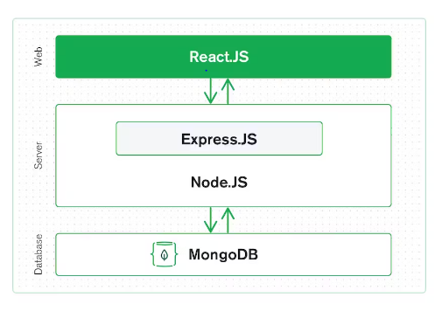
MERN Introduction
MongoDB — document database
Express(.js) — Node.js web framework
React(.js) — a client-side JavaScript framework
Node(.js) — the premier JavaScript web server

Slide 4
MERN Components - React
React is an open-source JavaScript library maintained by Facebook that can be used for creating views rendered in HTML
React is a JavaScript framework
Used for front end web development
Famous for implementing a virtual dom
used for building user interfaces specifically for single-page applications

Slide 5
Node.js
Node.js is JavaScript outside of a browser
A platform built on Chrome's JavaScript runtime for easily building fast, scalable network applications
Can handle thousands of Concurrent connections with Minimal overhead (cpu/memory) on a single process
It’s NOT a web framework, and it’s also NOT a language
JavaScript is well known for client-side scripts running inside the browser
node.js is JavaScript running on the server-side

Slide 6
Express
Express is a framework that simplifies the task of writing the server code.
Web application framework for Node.js
Express framework lets you define routes, specifications of what to do when an HTTP request matching a certain pattern arrives
Express middleware, custom pieces of code that can be inserted in any request/response processing path to achieve common functionality such as logging, authentication, etc.

Slide 7
MongoDB
MongoDB is the database used in the MERN stack
It is a NoSQL document-oriented database, with a flexible schema and a JSON-based query language
Document-oriented database
The unit of storage (comparable to a row) is a document, or an object, and multiple documents are stored in collections.
Every document in a collection has a unique identifier, using which it can be accessed
Notes:
Compared to relational databases where data is stored in the form of relations, or tables,

Slide 8
Need for MERN
JavaScript Everywhere - develop apps using JavaScript only
UI rendering and performance
Cost-Effective
Open Source
Easy to switch between client and server

Slide 9
Thank You

